Slide 1
Minimum Spanning Trees
Dr. Mohammad Rezwanul Huq

Slide 2
Problem: Laying Telephone Wire
Central office

Slide 3
Wiring: Naïve Approach
Central office
Expensive!

Slide 4
Wiring: Better Approach
Central office
Minimize the total length of wire connecting the customers

Slide 5
Minimum Spanning Trees
Given: Connected, undirected, weighted graph, G
Find: Minimum - weight spanning tree, T
Example:
b
7
c
5
Acyclic subset of edges(E) that connects
all vertices of G.
a
3
1
-3
11
d
0
e
2
f
5
b
c
a
1
3
-3
d
0
e
f

Slide 6
Minimum Spanning Tree (MST)
A minimum spanning tree is a subgraph of an undirected weighted graph G, such that
it is a tree (i.e., it is acyclic)
it covers all the vertices V
  contains |V| - 1 edges
the total cost associated with tree edges is the minimum among all possible spanning trees
not necessarily unique

Slide 7
Generic Algorithm
“Grows” a set A.
A is subset of some MST.
Edge is “safe” if it can be added to A without destroying this
invariant.
Generic-MST(G,w)
1. A := ∅;
2. while A does not form a spanning tree
3. find an edge (u, v) that is safe for A
4. A := A ∪ {(u, v)}
5. return A

Slide 8
Definitions
no edge in the set crosses the cut
cut respects the edge set {(a, b), (b, c)}
5
7
a light edge crossing cut
(could be more than one)
a
b
c
3
1
-3
cut partitions vertices into
disjoint sets, S and V – S.
11
d
e
f
0
2
this edge crosses the cut
one endpoint is in S and the other is in V – S.

Slide 9
Theorem 23.1:
Let G = (V, E) be a connected, undirected graph with a real valued weight function w defined on E.
Let A be a subset of E that is included in some minimum spanning tree for G
Let (S, V-S) be any cut that respects A, and let (u, v) be a light edge crossing (S, V-S).
Then, (u, v) is safe for A.

Slide 10
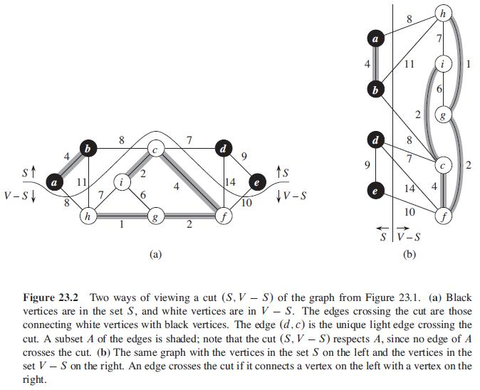

Slide 11
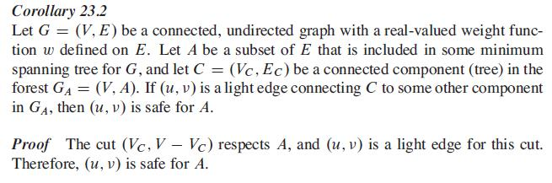
Corollary

Slide 12
Applications of MST
Any time you want to visit all vertices in a graph at minimum cost (e.g., wire routing on printed circuit boards, sewer pipe layout, road planning…)
Internet content distribution
  Idea: publisher produces web pages, content distribution network replicates web pages to many locations so consumers can access at higher speed
  MST may not be good enough!
    content distribution on minimum cost tree may take a long time!
Provides a heuristic for traveling salesman problems. The optimum traveling salesman tour is at most twice the length of the minimum spanning tree (why??)

Slide 13
How Can We Generate a MST?
9
b
9
b
a
2
6
a
2
6
d
d
4
5
4
5
5
4
5
4
5
e
5
e
c
c

Slide 14
One Approach
Create a forest of trees from the vertices
Repeatedly merge trees by adding “safe edges” until only one tree remains
A “safe edge” is an edge of minimum weight which does not create a cycle
9
b
a
2
6
d
forest: {a}, {b}, {c}, {d}, {e}
4
5
5
4
5
e
c

Slide 15
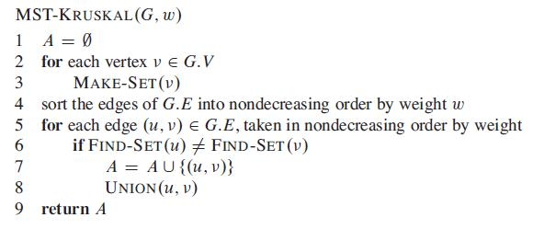
Kruskal’s algorithm

Slide 16
Running Time
Running time depended on the implementation of disjoint set data structure
Kruskal’s Algorithm consists of two stages.
  Initializing the set A in line 1 takes O(1) time.
  Sorting the edges by weight in line 4.
    takes O(E lg E)
  Performing
    |V| MakeSet() operations for loop in lines 2-3.
    |E| FindSet(), for loop in lines 5-8.
    |V| - 1 Union(), for loop in lines 5-8.
    which takes O(V + E)
The total running time is
  O(E lg E)
  We have lg │E│ = O(lg V) because # of E = V-1
  So total running time becomes O(E lg V).

Slide 17
Kruskal’s algorithm
9
b
E = {(a,d), (c,d), (d,e), (a,c),
(b,e), (c,e), (b,d), (a,b)}
a
2
6
d
4
5
5
4
5
e
c
Forest
{a}, {b}, {c}, {d}, {e}
{a,d}, {b}, {c}, {e}
{a,d,c}, {b}, {e}
{a,d,c,e}, {b}
{a,d,c,e,b}
A
∅
{(a,d)}
{(a,d), (c,d)}
{(a,d), (c,d), (d,e)}
{(a,d), (c,d), (d,e), (b,e)}

Slide 18
Kruskal’s Algorithm Invariant
After each iteration, every tree in the forest is a MST of the vertices it connects
Algorithm terminates when all vertices are connected into one tree

Slide 19
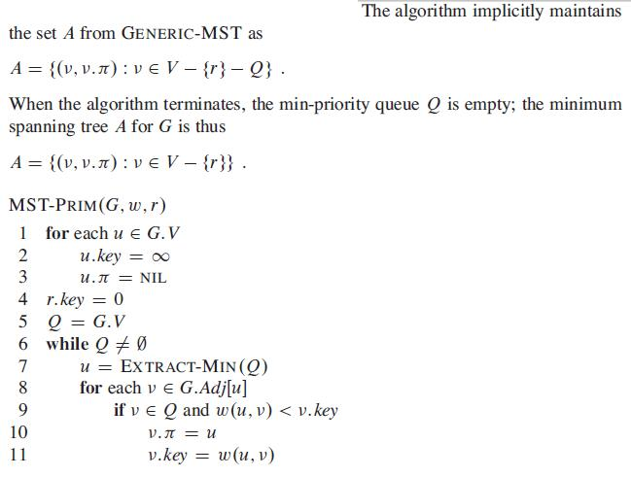
Prim’s Algorithm

Slide 20
Prim’s Algorithm
Initialization
a. Pick a vertex r to be the root
b. Set r.key = 0, parent(r) = null
c. For all vertices v ∈ V, v ≠ r, set v.key = ∞
d. Insert all vertices into priority queue Q,
using distances as the keys
9
Vertex Parent
e -
b
a
2
6
e
a
b
c
d
d
4
5
0
∞
∞
∞
∞
5
4
5
e
c

Slide 21
Prim’s Algorithm
While Q is not empty:
1. Select the next vertex u to add to the tree
u = Q.ExtractMin()
2. Update the weight of each vertex v adjacent to u which is not in the tree (i.e., v ∈ Q)
If weight(u,v) < v.key,
a. parent(v) = u
b. v.key = weight(u,v)
c. Update the priority queue to reflect
new distance for v

Slide 22
Prim’s algorithm
Vertex Parent
e -
b -
c -
d -
e
d
b
c
a
9
b
0
∞
∞
∞
∞
a
2
6
d
4
5
5
4
Vertex Parent
e -
b e
c e
d e
5
e
d
b
c
a
c
4
5
5
∞
The MST initially consists of the vertex e, and we update
the distances and parent for its adjacent vertices

Slide 23
Prim’s algorithm
Vertex Parent
e -
b e
c e
d e
d
b
c
a
9
b
4
5
5
∞
a
2
6
d
4
5
5
4
Vertex Parent
e -
b e
c d
d e
a d
5
e
c
a
c
b
2
4
5

Slide 24
Prim’s algorithm
Vertex Parent
e -
b e
c d
d e
a d
a
c
b
9
b
2
4
5
a
2
6
d
4
5
5
4
5
e
c
Vertex Parent
e -
b e
c d
d e
a d
c
b
4
5

Slide 25
Prim’s algorithm
Vertex Parent
e -
b e
c d
d e
a d
c
b
9
b
a
4
5
2
6
d
4
5
5
4
5
e
Vertex Parent
e -
b e
c d
d e
a d
c
b
5

Slide 26
Prim’s algorithm
Vertex Parent
e -
b e
c d
d e
a d
b
9
b
5
a
2
6
d
4
5
5
4
5
e
c
Vertex Parent
e -
b e
c d
d e
a d
The final minimum spanning tree

Slide 27
Running time of Prim’s algorithm
Initialization of priority queue (array): O(V)
while loop: |V| times
  Each EXTRACT-MIN O(lgV) ➔ O(VlgV)
for loop: O(E) times
  Assignment in line 11 involves implicit DECREASE-KEY operation O(lgV) ➔ O(ElgV)
Overall Running time: O(VlgV+ElgV) = O(ElgV)

Slide 28
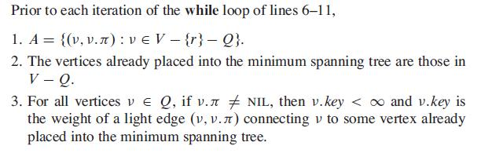
Prim’s Algorithm Invariant

